Slide 1
ADS 500B-02-FA21 Final Project: Bank Marketing
Aaron Carr & Claire Phibbs
Notes:
Hi welcome to the final presentation for data science programming. My name is aaron & my partner is clair.

Slide 2
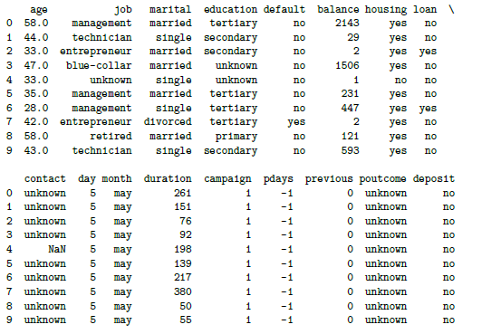
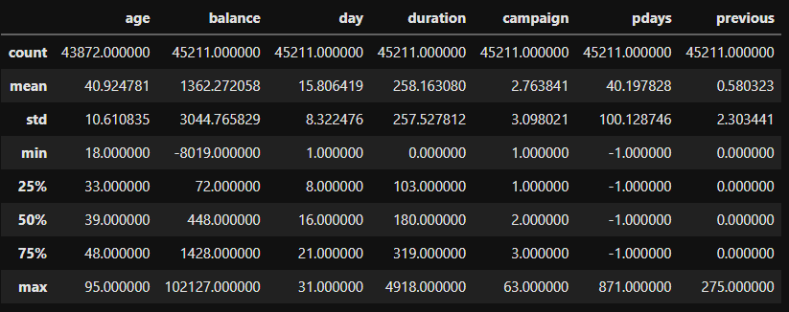
Initial Review of Data & Measures
Figure 1. Dataframe
Data loaded into Python pandas dataframe from csv file
Display dataframe to visually explore data (Fig. 1)
Descriptive stats (Fig. 2)
Figure 2. Descriptive Statistics
Review missing data and data types (next slide)
Notes:
We began our analysis of the bank marketing dataset by loading the csv file into a Python pandas dataframe. We then displayed the dataframe with all features and a sample of records, followed by a presentation of descriptive statistics for the numerical variables.

Slide 3
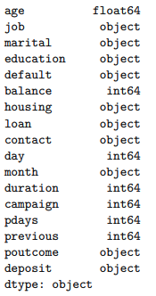
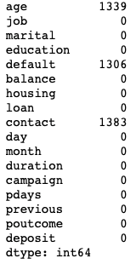
Bank Marketing Dataset Characteristics
Variable Types
Null Value Count by Variable
Notes:
On the left we have Python data types of the variables and on the right we have a tally of all variables and their null value count, to be used as a reference for further processing and cleaning.

Slide 4
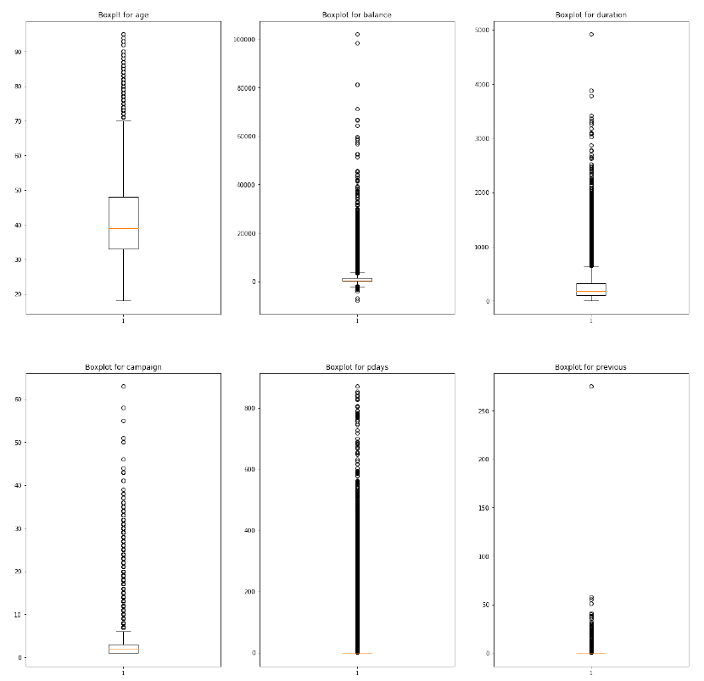
Initial Visualizations
Review Boxplots
Plot all numerical vars together
Check variance, IQR, and outliers
Notes:
We then visualized numerical variables in full dataset using boxplots, which provide displays of the IQR (including median), as well as variance and outliers.
All plots have outliers and are skewed right to various degrees. For age, there is a sizable variance within the IQR, whereas for balance the data is much more condensed about the mean.

Slide 5
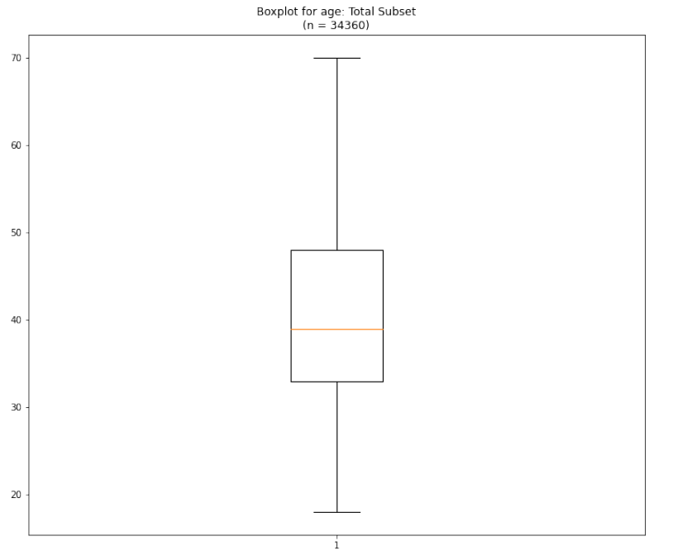
Cleaning & Transforming Data
Fill in missing data using appropriate methods
E.g., null ‘age’ values filled in using mean substitution by grouped aggregation on marital status & education level
Eliminate columns not needed for analysis (e.g., ‘contact’)
Create new features to simplify analysis
New feature ‘previous_contact’ (yes/no) based on ‘pdays’ = -1
Discretize categorical variables
Create dummy variables, otherwise
Transform ambiguous values
E.g., change “unknown” for education based on mode value of group aggregates
Final boxplot & data reviews
Notes:
As part of the actual cleaning, we filled in missing data based on aggregation and mean substitution. Some columns not needed for analysis were removed. New features were added, including “previous_contact” which is imputed from pdays = -1 (or no previous contact). Categorical variables also needed to be discretized by creating dummy variables. An example of a boxplot in the final dataset is the one for age on the right.

Slide 6
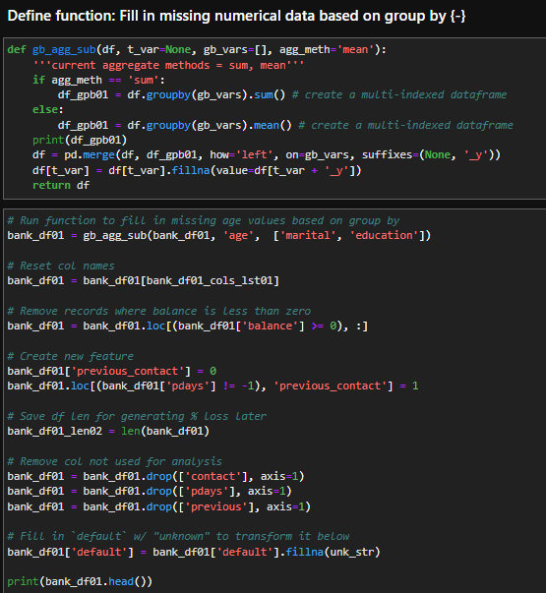
Code Example: Define Fx & Run Transx
Notes:
This slide includes a snippet of code. On the top is function defined to aggregate and fill in missing data for a numerical variable. Below is the execution of the function, as well as the additional code steps to perform additional cleaning and transformations steps.

Slide 7
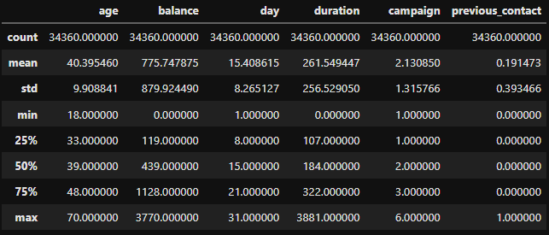
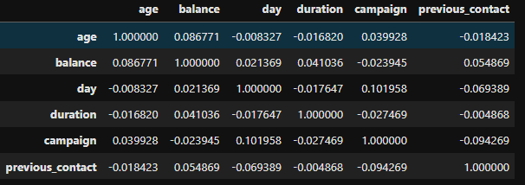
Post-processing Review
Figure 3. Descriptive Statistics
After cleaning and trimming the data perform additional reviews
Figure 4. Correlation Matrix
Notes:
After processing, a final review was done to look at the updated descriptive statistics. Also a correlation matrix was generated, whereby you can see the greatest correlation is only .1 between campaign and day.

Slide 8
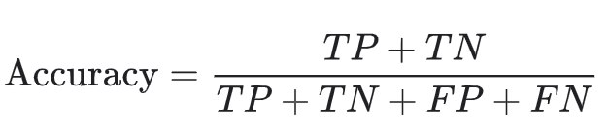
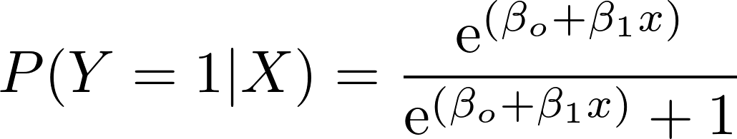
Formulas for Logistic Regression Models
Logit Function:
ROC: True Positive Rate ~ False Positive Rate

Slide 9
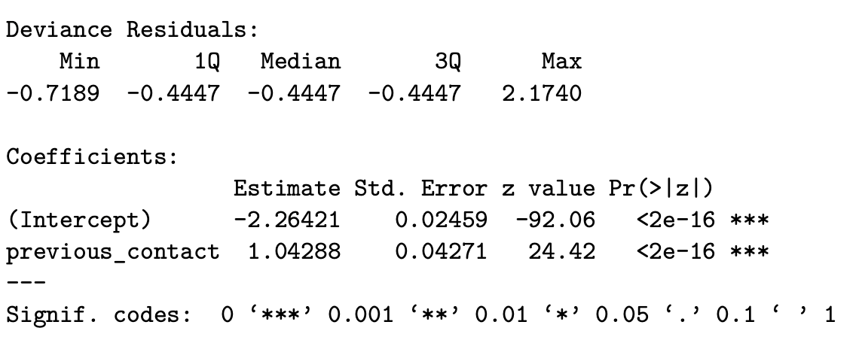
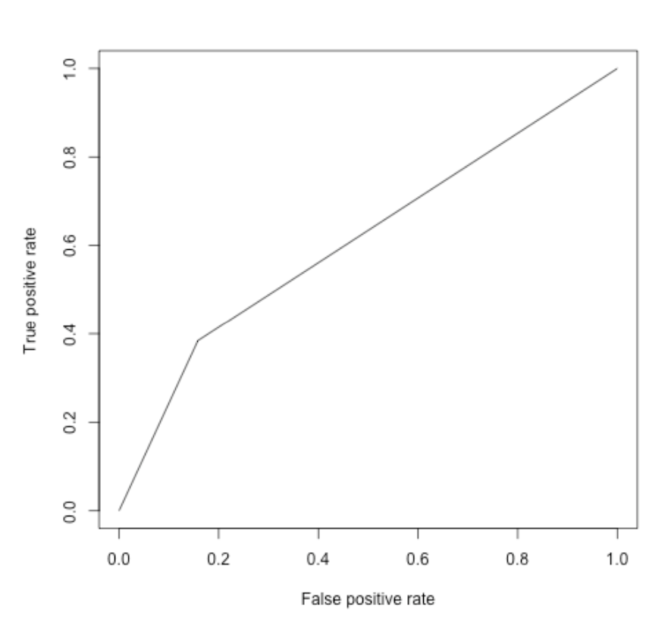
Model 1: Deposit~previous_contact
AUC=0.6131
Accuracy=0.8786
*Models Predictive Ability→ weak due to only (1) predictor

Slide 10
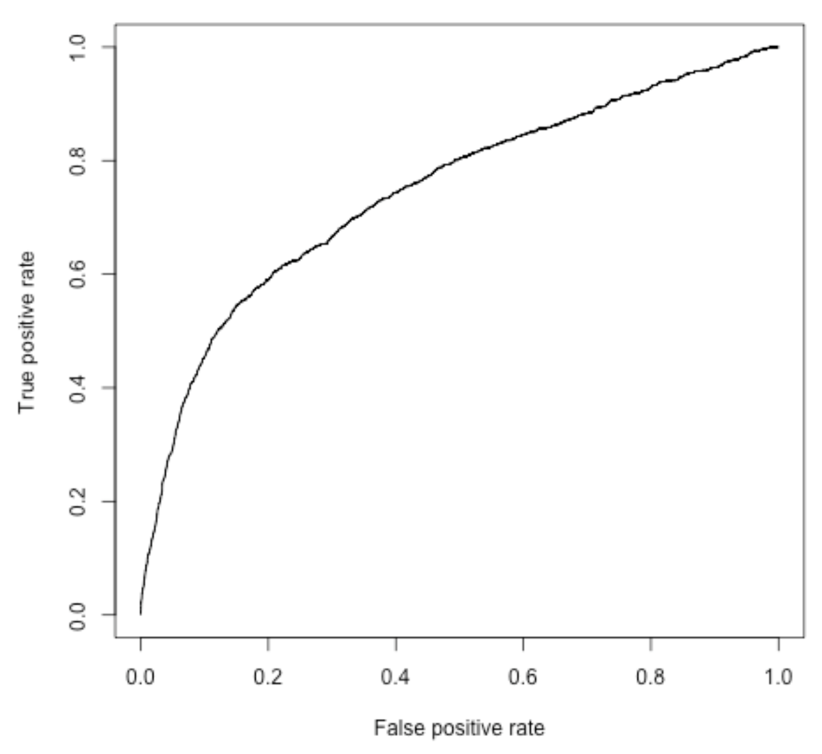
Model 4: Deposit~age+72 other predictor variables (Full Model)
AUC=0.7458
List of Perfectly Linearly Dependent Variables:
Job_housemaid
Marital_divorced
Education_unknown
Default_no
Housing_no
Loan_yes
Day_31
Month_sep
These variables did not output any coefficients due to their “perfect” linear dependence. They have been removed in the next model.
*Models Predictive Ability→ moderate due to high number of predictors but not accounting for linear dependence
Accuracy=0.8815

Slide 11
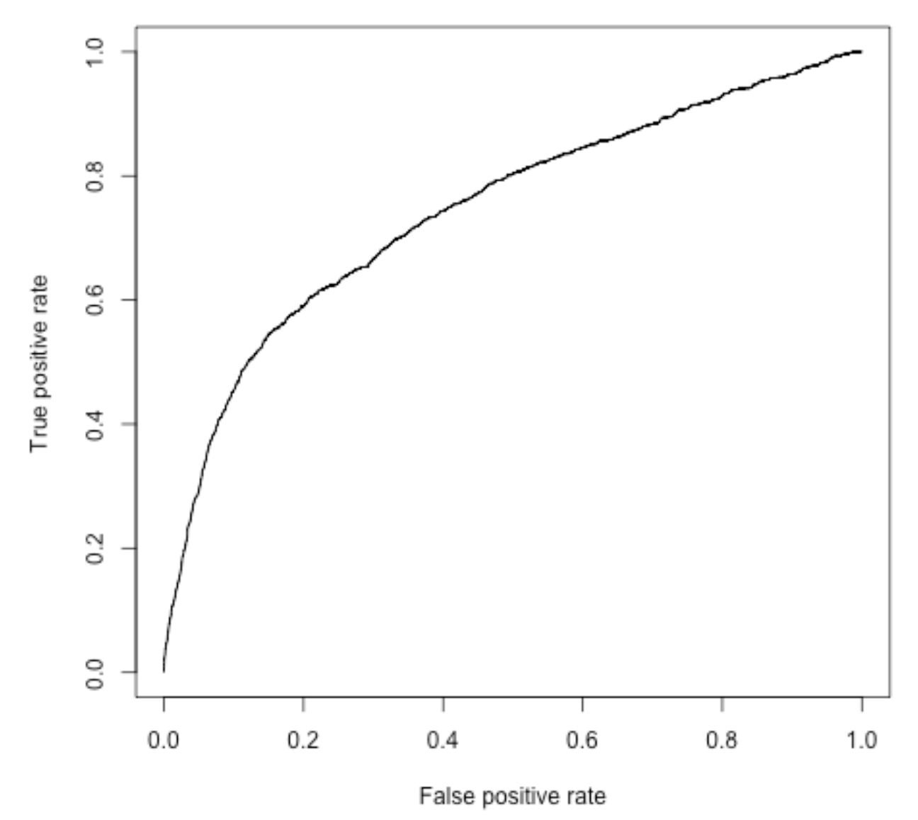
Model 5: Deposit~age+64 other predictor variables (Trimmed Model)
AUC=0.5458
Accuracy=0.8815
VIFs calculated to check linear dependence of predictors → many predictors with VIF>2.5
*Models Predictive Ability→ relatively weak due to the larger number of predictors used but some of them still exhibiting high degree of linear dependence.

Slide 12
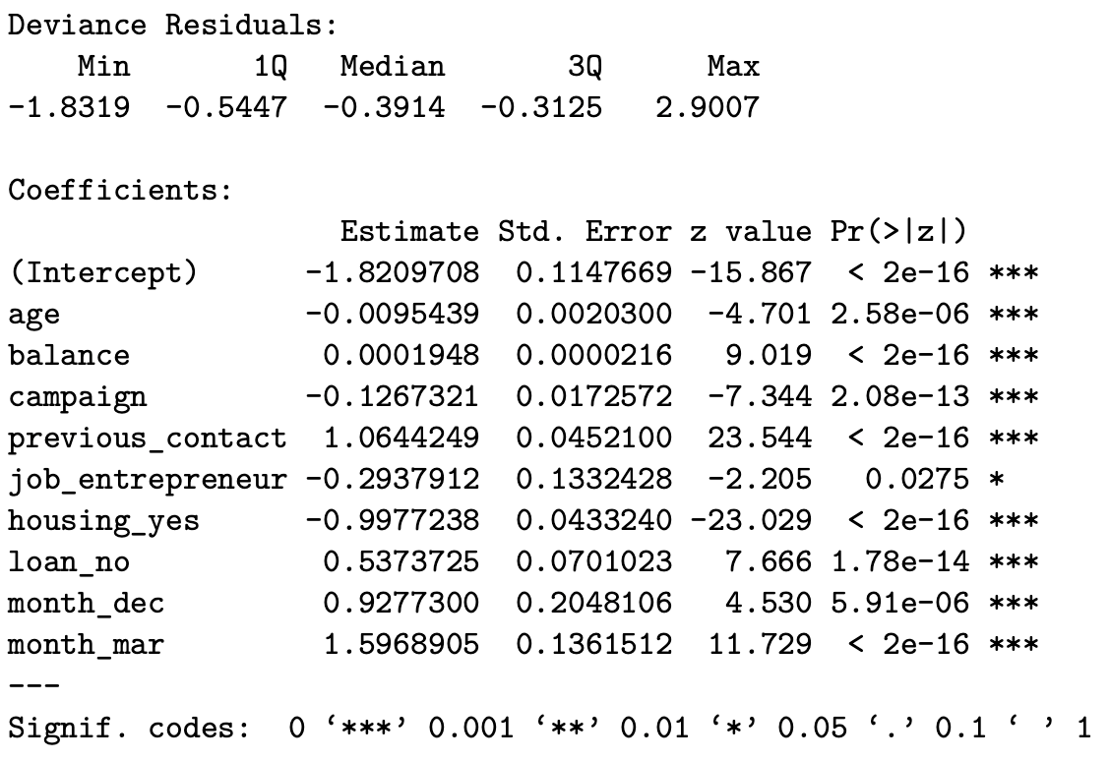
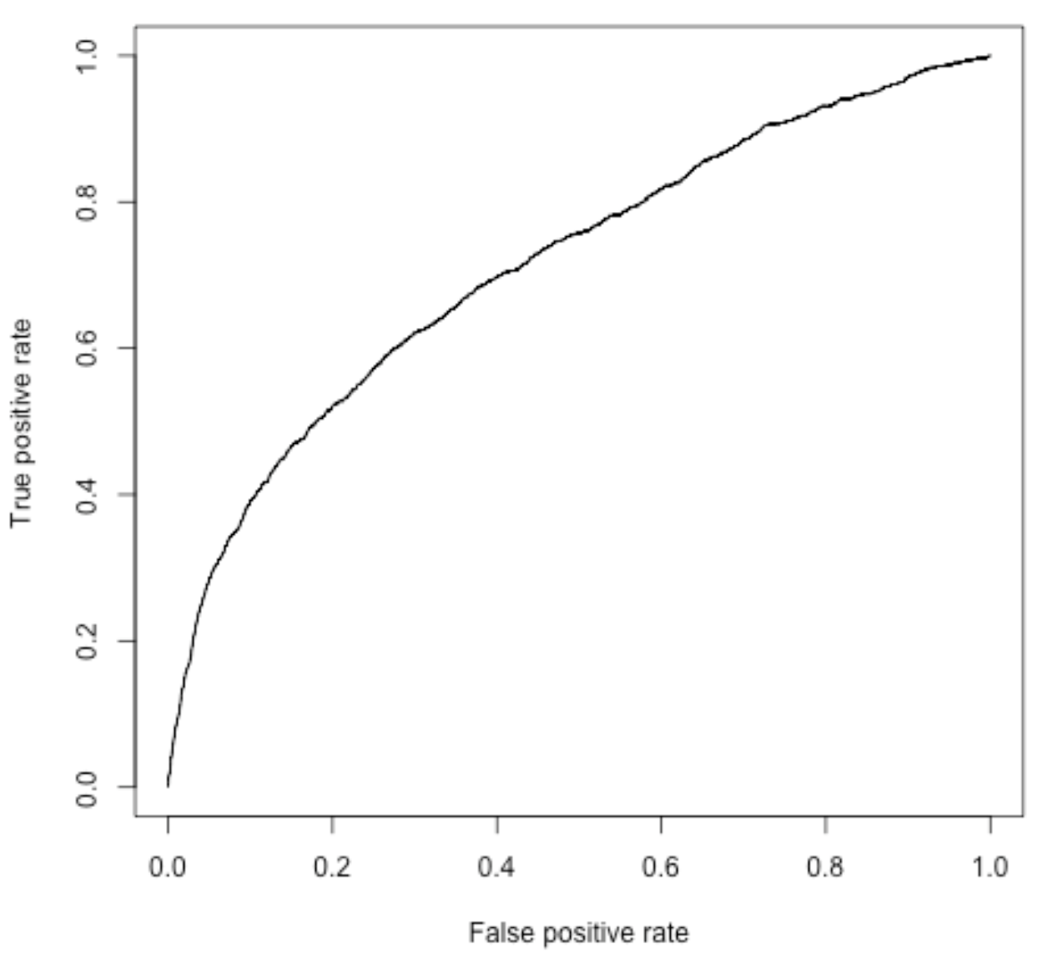
Model 7: Deposit~age+balance+campaign+previous_contact+job_entrepreneur+housing_yes+loan_no+month_dec+month_mar
AUC=0.7150
Accuracy=0.8805
*Models Predictive Ability→ moderate due to predictors used & significance of predictors

Slide 13
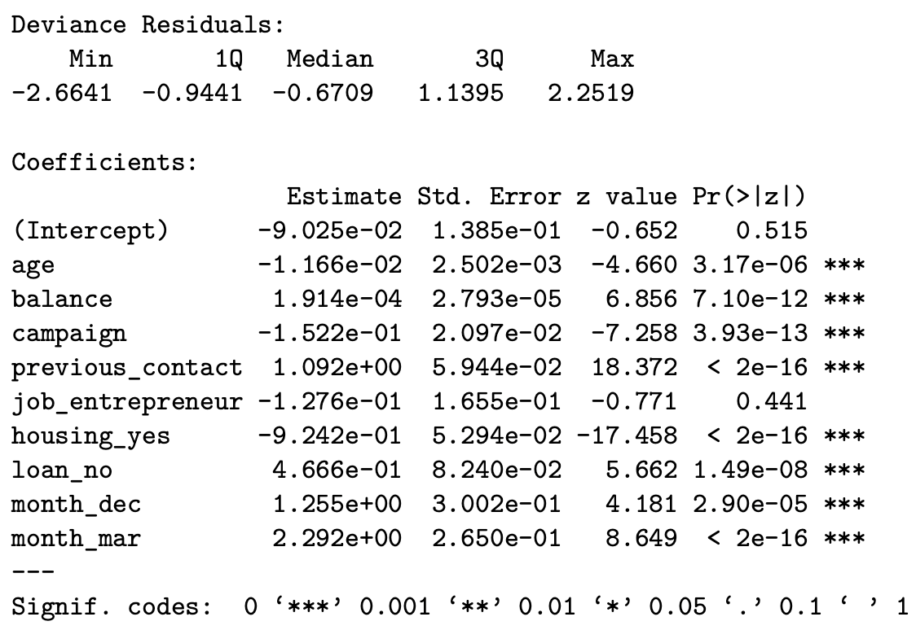
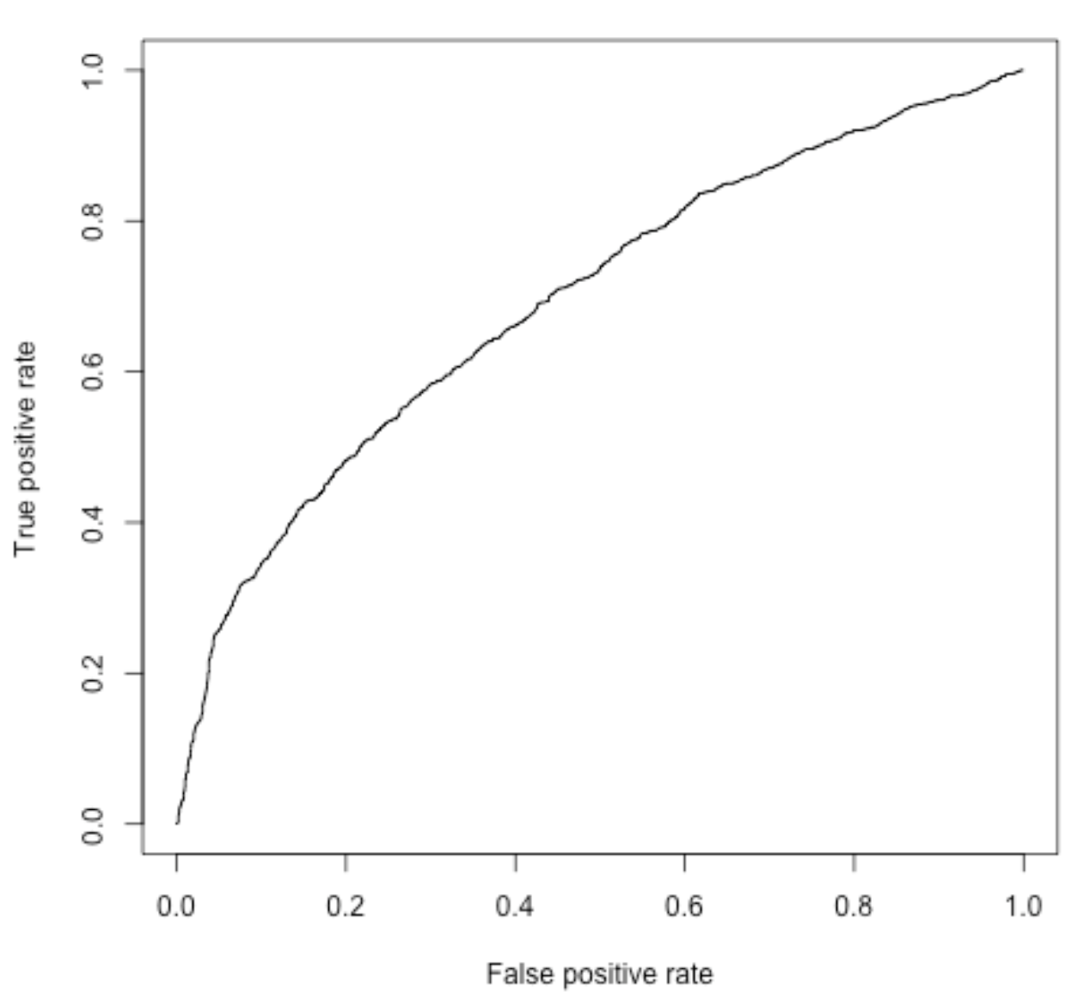
Model 7b: Final Model on Subset Where “yes” ~40% of the Sample
AUC=0.6935
Accuracy=0.6814
*Models Predictive Ability→ Similar to model 7, but the AUC and accuracy actually decreased
Notes:
As an additional validation step, to see if the ratio of “yes” to “no” of the deposit variable in the full cleaned dataset had an impact on the model’s predictability, we created a subset to increase the ratio of “yes” values from ~12% to 40%. In the end, performance was actually lower as seen by accuracy and AUC decreases relative to model 7.

Slide 14
Concluding Thoughts
Based on full EDA and logistic regression, trimmed Model 7 predicts deposit status the best compared to the other models provided.
Study strengths included a large dataset and integration of Python & R
Limitations due to data make up, e.g., ratios of values & large number of categorical variables
Notes:
Our analyses had both strengths and limitations. Strengths include having a large dataset to train our models, all well as integration of both Python and R applications to leverage their individuals strengths, such as efficient data processing in Python and robust statistical analysis in R.
Limitations included the makeup of the data itself, including ratios of categorical values within variables (as described for model 7b), as well as a large number of categorical variables that had to be discretized resulting in more than 70 features to choose from to develop the best model.

Slide 15
References
Coban, H. (2019). Here's how I used Python to build a regression model using an e-commerce dataset. https://searchengineland.com/heres-how-i-used-python-to-build-a-regression-model-using-an-e-commerce-dataset-326493
Devore, J. L. (2016). Probability and statistics. (9th ed.). Cengage Learning.
Mukala, M. M. (2012). A guide to appropriate use of correlation coefficient in medical research. Malawi Medical Journal, 24(3), 69-71.
Real Python. (n.d.). Linear regression in python. https://realpython.com/linear-regression-in-python/
Real Python. (n.d.). Logistic regression in python. https://realpython.com/logistic-regression-python/
Shah, C. (2020). A hands-on introduction to data science. Cambridge University Press.
Stack Overflow. (n.d.). GroupBy pandas dataFrame and select most common value. https://stackoverflow.com/questions/15222754/groupby-pandas-dataframe-and-select-most-common-value
UCLA: Statistical Consulting Group. Introduction to SAS. https://stats.idre.ucla.edu/sas/modules/sas-learning-moduleintroduction-to-the-features-of-sas/ (accessed December 12, 2021).
Notes:
Thank you so much for watching our presentation for ADS500B, data science programming.

Slide 16
ADS 500B-02-FA21 Final Project: Bank Marketing
Aaron Carr & Claire Phibbs

